Slide 1


DevOps Docker

Slide 2




Prerequisite
Use Workshop-VM / Workshop-Computer follow the instructions of the Boarding Pass
Visual Studio Code
https://code.visualstudio.com
Git
https://git-scm.com
Competence Team DevTech
Microsoft AL

Slide 3
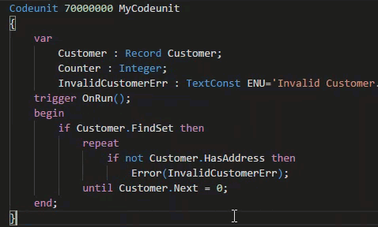
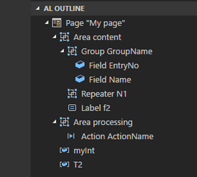
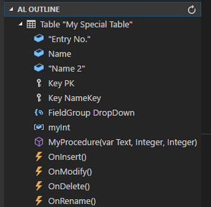
VS Code Useful Extensions
AL Formatter
Indentation
Keyword case style
Sort variable definitions
Readability Guidelines - Spacing and newlines (experimental)
AL Code Outline
Outlining – AL Object Structure
“Create List Page” from Table
“Create Card Page” from Table
al-util
“Rename & Move” Objects
Templates e.g. “Readme.md”

Slide 4


1
Docker, NAV on Docker, Docker Commands
2
Hand On
AGENDA
3
Powershell, NAV Container Helper
4
Hands On
5
Q & A
6
KUNDEN VON COSMO CONSULT
7
COSMO CONSULT INTERNATIONAL / GLOBAL SERVICE

Slide 5

Infrastructure
Docker
5

Slide 6

Infrastructure | Docker www.docker.com Overview
Isolate application's view of the operating environment
Easy & Simple Application Deployment
Requirements
Windows 10 / Windows Server 2016
Recommended 16GB Ram & 40 GB HDD on C:
Hyper-V enabled
Install Docker for Windows
After Docker Installation
Switch Container Mode to “Windows” (Docker @ Taskbar Icon → [Right Click] Menu → Switch to Windows Container Mode) this may require a restart
Documentation
Source: https://de.wikipedia.org/wiki/Datei:Docker_(container_engine)_logo.png

Slide 7
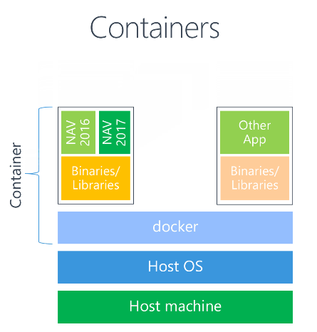
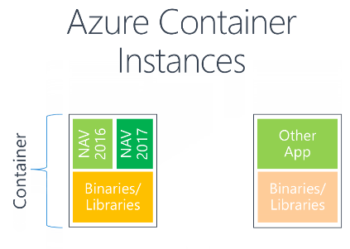
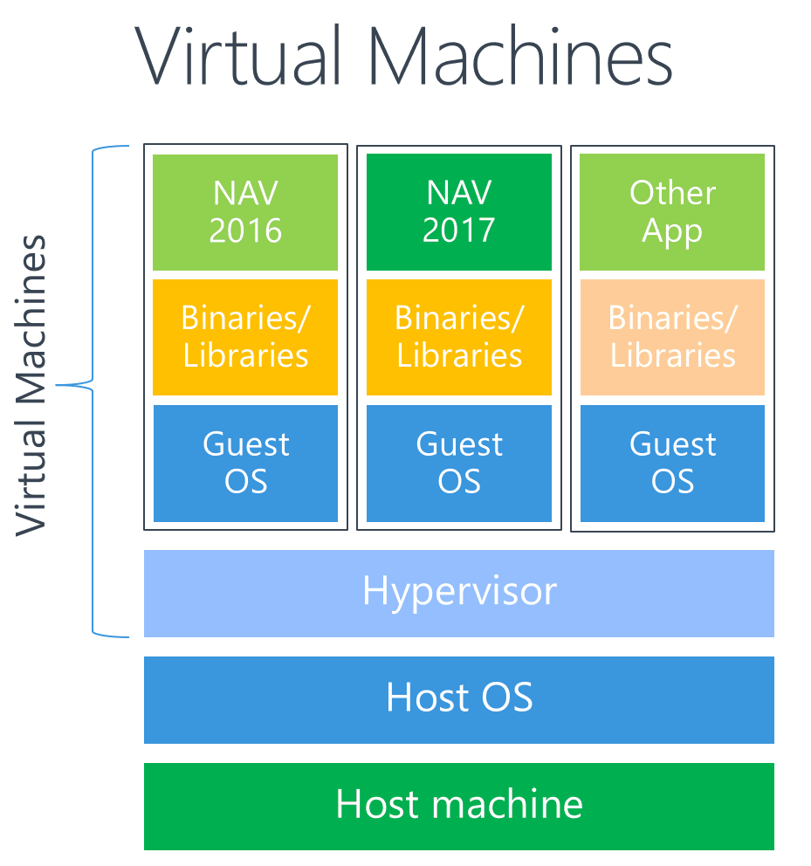
Infrastructure | Docker NAV in Containers
Source: https://blogs.msdn.microsoft.com/freddyk/2017/10/31/what-is-docker-what-are-containers/

Slide 8
Infrastructure | Docker NAV Containers
Pull (Download the Image) Repository\<Image-Name>[:<Tag>]
NAV Container
Windows Server Nano
SQL Server Express CORNUS DB
Web-Server
Navision in the right version: NST, WebClient, RTC, C/Side (FinSQL.exe)

Slide 9
Docker Common Commands Cheat-Sheet
List all containers
$ docker ps -a
List all images
$ docker images -a
Fetch the logs of a container
$ git logs <container ID or Name>
Kill a container
$ docker kill <container ID or Name>
Remove a containers
$ docker rm <container ID or Name>
Remove a container image
$ docker rmi <image ID>
To start working in a different branch, use git checkout to switch branches.
$ git checkout <branch_name>

Slide 10

Hands On

Slide 11
Git Hands On
Material
Project Skeleton „03-DevOps-Git\Starter\COSMO-CONSULT-1\”
Project Skeleton „03-DevOps-Git\Starter\COSMO-CONSULT-2\”
Project Skeleton „03-DevOps-Git\Starter\COSMO-CONSULT-3\”
Prerequisites
Connect to your Workshop VM → use Instructions on your Workshop Boarding Pass
Hand On - Tasks
Achieve common development related tasks with the Git command line
Achieve common development related tasks with the VS Code and the Git Integration
Achieve common development related tasks with the a 3rd Party Tool

Slide 12

Infrastructure
NAV-Container-Helper
12

Slide 13
NAV Container Helper Common Commands Cheat-Sheet
List common Commands
$ Write-NavContainerHelperWelcomeText
Create new C/SIDE development container
$ New-CSideDevContainer
Create new Nav container
$ New-NavContainer -accept_eula -containerName <name> -imageName "Microsoft/dynamics-nav:2018-cu4-de"
$
$
$
$

Slide 14
Hands On

Slide 15
Git Hands On
Material
Project Skeleton „03-DevOps-Git\Starter\COSMO-CONSULT-1\”
Project Skeleton „03-DevOps-Git\Starter\COSMO-CONSULT-2\”
Project Skeleton „03-DevOps-Git\Starter\COSMO-CONSULT-3\”
Prerequisites
Connect to your Workshop VM → use Instructions on your Workshop Boarding Pass
Hand On - Tasks
Achieve common development related tasks with the Git command line
Achieve common development related tasks with the VS Code and the Git Integration
Achieve common development related tasks with the a 3rd Party Tool

Slide 16

Q & A
Competence Team DevTech
Channel Microsoft AL

